Slide 1
Exploring restaurants in Mumbai - India

Slide 2
Introduction
The purpose of this project is to determine restaurants in Mumbai, India based on rating and average price. Restaurants will be identified in Mumbai, India using Foursquare API and Zomato API, to help visitors select the restaurants that suit them the best.
People visiting a new city, start looking for restaurants during their stay. They primarily look for restaurant based on the rating and average price among all other restaurants near it such that the it fits their bill.
Therefore, restaurants will be identified that are fit for various individuals based on the information collected from the two APIs and Data Science methodology.

Slide 3
Data Collection
Data will be fetched from following two APIs:
Foursquare API: to fetch restaurants in Mumbai within 5 KMs radius.
https://developers.zomato.com/api
Zomato API: provides complete information of restaurant like address, user ratings, price for two people, price range and lot more.
https://developer.foursquare.com/

Slide 4
Analysis

Slide 5
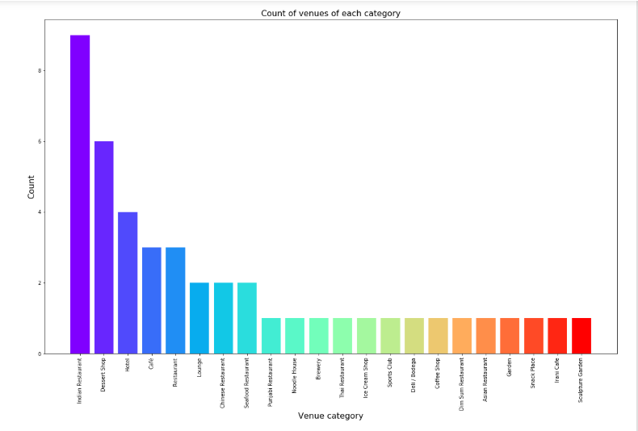
Count of venues of each category

Slide 6
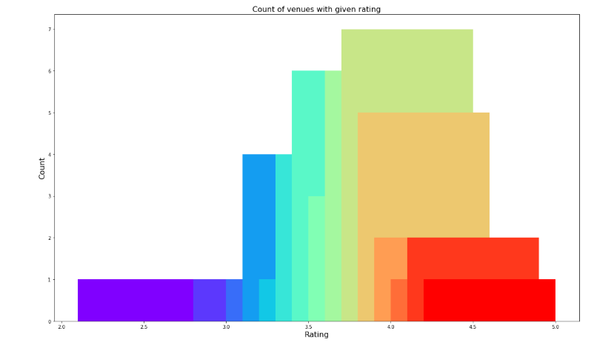
Count of venues with given rating

Slide 7
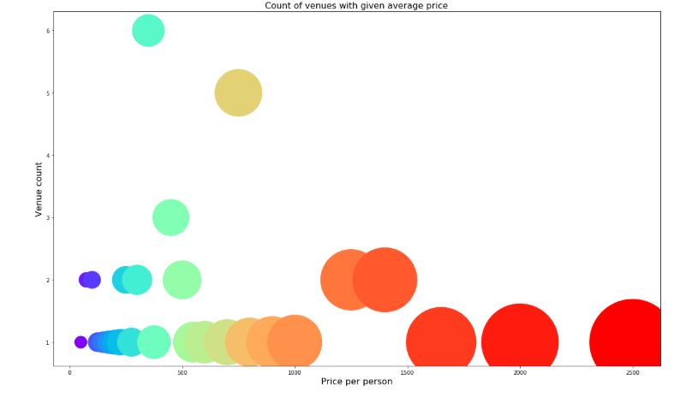
Count of venues with given average price

Slide 8
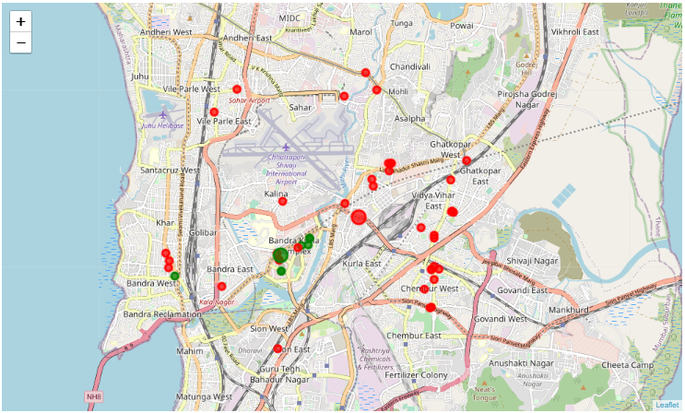
Clustering

Slide 9
Results
Cluster-0: 1. Infrequently spread and has very limited restaurants
2. Has mean price range of 4.00 and rating spread around 4.23
Cluster-1: 1. Scattered across the city and includes the majority restaurants
2. Has mean price range of 2.11 and rating spread around 3.86

Slide 10
Conclusion
It can be concluded that Cluster-0 region is expensive and has a high rating and Cluster-1 region is in affordable price range and has mediocre rating.

